Slide 1
Modeling Micro-Cap Stock Growth
Analysis by Brian Bentson

Slide 2
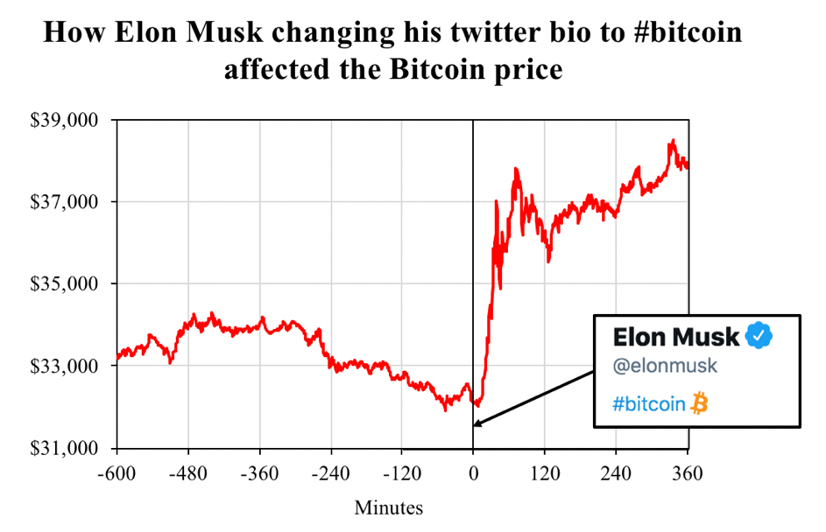
Capitalizing on Market Inefficiencies by finding undervalued micro-cap stocks
Market inefficiencies exist when a stocks price does not accurately reflect the stocks true value
Finding stocks which are currently undervalued where their true value is much higher than their price suggests
Micro-cap companies have high inefficiencies due to low visibility especially in large investment institutions (Small Firm Effect)
Source: https://www.blockchainresearchlab.org/2021/02/08/the-musk-effect-how-elon-musks-tweets-affect-the-cryptocurrency-market/

Slide 3
Data Overview
FMP
Sourced data from FMP’s API
Pulled general stock info (stock ticker, company name, industry, country etc.)
Pulled 5 key value performance metrics for 2020
Pulled all historical data for revenue per share
Removed highly volatile sectors (Financial, BioTech, Project Management/Construction)
Financial Modeling Prep

Slide 4
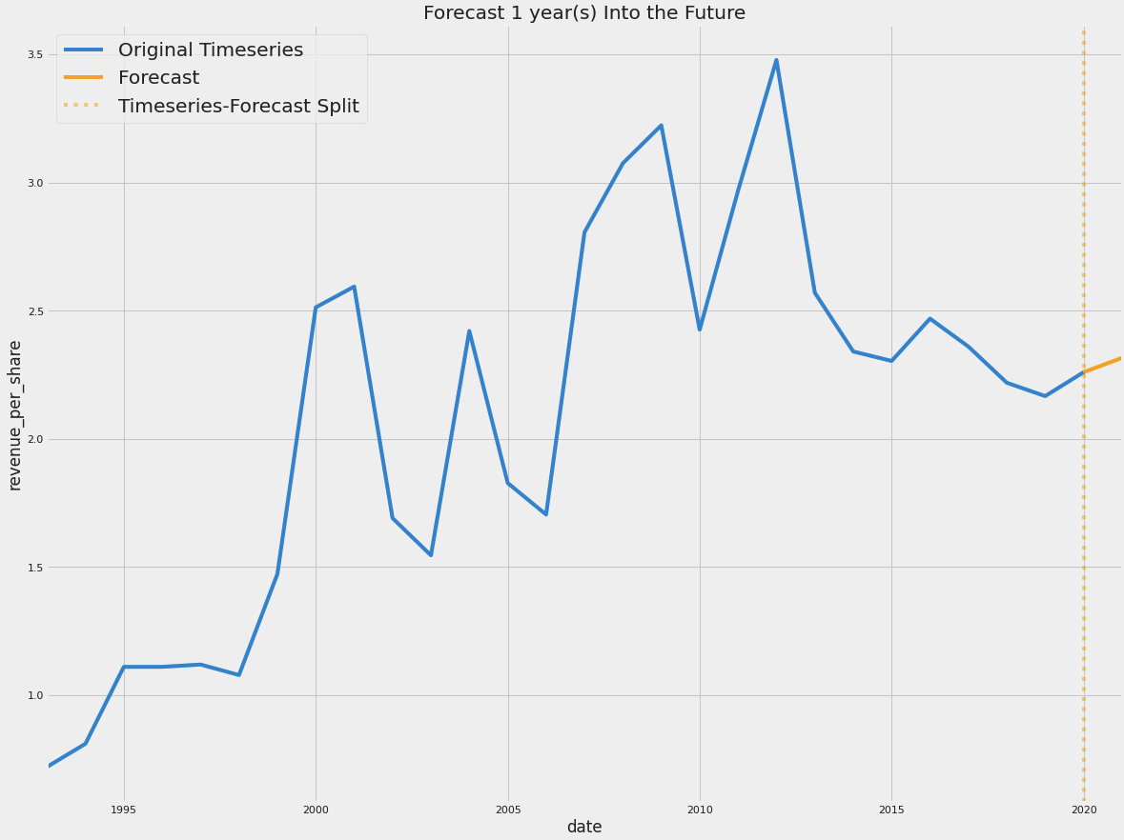
Analysis: Finding Market Inefficiencies using key performance metrics
Focused on Micro-cap stocks
Ranked based on 5 “Value” performance metrics in 2020:
Value Performance Metrics
Price to Expense Ratio
Enterprise Value to Operating Cashflow
Enterprise Value Over EBITDA
Enterprise Value to Free Cashflow
Price to Sales Ratio
2.48% Forecasted Increase in Revenue per Share
Forecasted Top 10 “Value” stocks on revenue per share, 1 year into the future
Ranked growth potential based on predicted 1 year percent growth of revenue per share

Slide 5
Analysis Results
Symbol ID | 2020 Value Ranking | 1 Year Growth Rate | Growth Ranking | Total Ranking
19264 | 1 | 4.34% | 4 | 2
10161 | 2 | 8.37% | 2 | 1
6760 | 3 | -5.35% | 8 | 4
17272 | 4 | -10.71% | 9 | 6
7134 | 5 | -52.25% | 10 | 8
343 | 6 | -1.31% | 6 | 5
9074 | 7 | -5.32% | 7 | 7
14746 | 8 | 10.25% | 1 | 3
13554 | 9 | 4.39% | 3 | 5
18302 | 10 | 3.45% | 5 | 8
The last 3 stocks in value show the best growth potential in a year
The Total Ranking does not offer great granularity since only 10 stocks were modeled. More modeling will allow Total Ranking to provide more insight
Mixture of auto-fit models and manual fit models due to high volatility in revenue per share, specifically in 2020

Slide 6

Conclusion and Next Steps
Adding the growth potential outlook adds insight to help find inefficient stocks to purchase
The combination of high performing value metrics and growth potential is key to finding undervalued stocks
Model more stocks to get a clearer view of smart buys of undervalued stocks
Explore additional metrics that track company growth such as stock price
This Photo by Unknown Author is licensed under CC BY-NC-ND

Slide 7
Thank you
Questions?

Slide 8
Appendix

Slide 9
2.48% Forecasted Increase in Revenue per Share

